Slide 1
CPSC 5100
Nov 19 – Finding the Voice of the User

Slide 2
Voice of the user
Getting the customer voice close to the developer ear

Slide 3
How do I find the voice of the user?
Identify the different classes of users for the product
Select and work with representatives from each class
…and other stakeholder groups
Agree on who makes the decisions for the group
…remember when we talked about decision making?

Slide 4
Classifying users
The access privilege or security levels
The tasks they perform or their role in the organization
The features they use
The frequency with which they use the product
Their application domain experience
The platforms they use (PC, laptop, tablet, phone, other)
Their native language
Whether they will directly or indirectly interact with the software

Slide 5
The stakeholder hierarchy
Stakeholders
Customers
Direct and Indirect Users
Other Customers
Other stakeholders
Favored user classes
Disfavored user classes
Ignored user classes
Other user classes

Slide 6
Higher-level user classes
Favored user classes
Users whose satisfaction is most closely aligned with the business objectives
Disfavored user classes
Users who shouldn’t use the product because of legal, security, or safety
Ignored user classes
All the rest who don’t fit neatly into one of the above

Slide 7
Different user classes?
Scenario: company that builds software for the banking industry
Large commercial bank
Small commercial bank
Savings and loan institution
Credit union
Those are market segments, not user classes
Teller, loan officer, business banker, branch manager
Look at scenarios, use cases, user stories and process flows for others

Slide 8
Finding user classes – Expand then contract
Ask the project sponsor who the expected users are
Brainstorm as many other classes and you can think of
Don’t get nervous, there may be dozens
Now, look for groups with similar needs
Now, categorize and condense
Shoot for 12 – 15 distinct user classes
Ellen Gottesdiener
Requirements by Collaboration: Workshops for Defining Needs (2002)

Slide 9
Wallowing in the org chart
Departments that participate in the business process
Departments that are affected by the business process
Departments or role names in which (in)direct users might be found
User classes that span multiple departments
Department with possible interface to external stakeholders

Slide 10
Example user classes
Name | Number | Description
Chemists | ~1,000 across 6 buildings | Chemists request chemicals from vendors and from the stockroom. Each chemist will use the system several times per day, mainly for requesting and tracking chemical containers. The chemists need to search vendor catalogs for specific chemical structures…
Buyers | 5 | Buyers in the purchasing department process requests. They place and track orders with external vendors. They know little about chemistry and need simple query facilities to search the vendor catalogs. Buyers might use the system ~25 times per day…
Stockroom staff | 6 techs 1 manager | The stockroom staff manages the inventory of more than 500,000 chemical containers. They supply containers from three stockrooms, request chemicals from vendors, and track movement of containers. They are the only user of the inventory-reporting feature. Their access must be automated and efficient…
Health & Safety | 1 manager | The H&S department will only use the system to generate predefined quarterly reports to comply with federal and state chemical use, storage, and disposal regulations. The H&S department will make occasional requests to change reports based on regulatory requirements. The changes are highly time-critical.

Slide 11
User personas
To help bring user classes to life, create a persona for each
This is a description of a hypothetical, generic person
Give them a real name and consider providing a picture
Details might include
Social and demographic characteristics
Behaviors, roles, and responsibilities
Preferences and annoyances
The persona is the user class archetype
Ask “What would Fred need to do?”

Slide 12
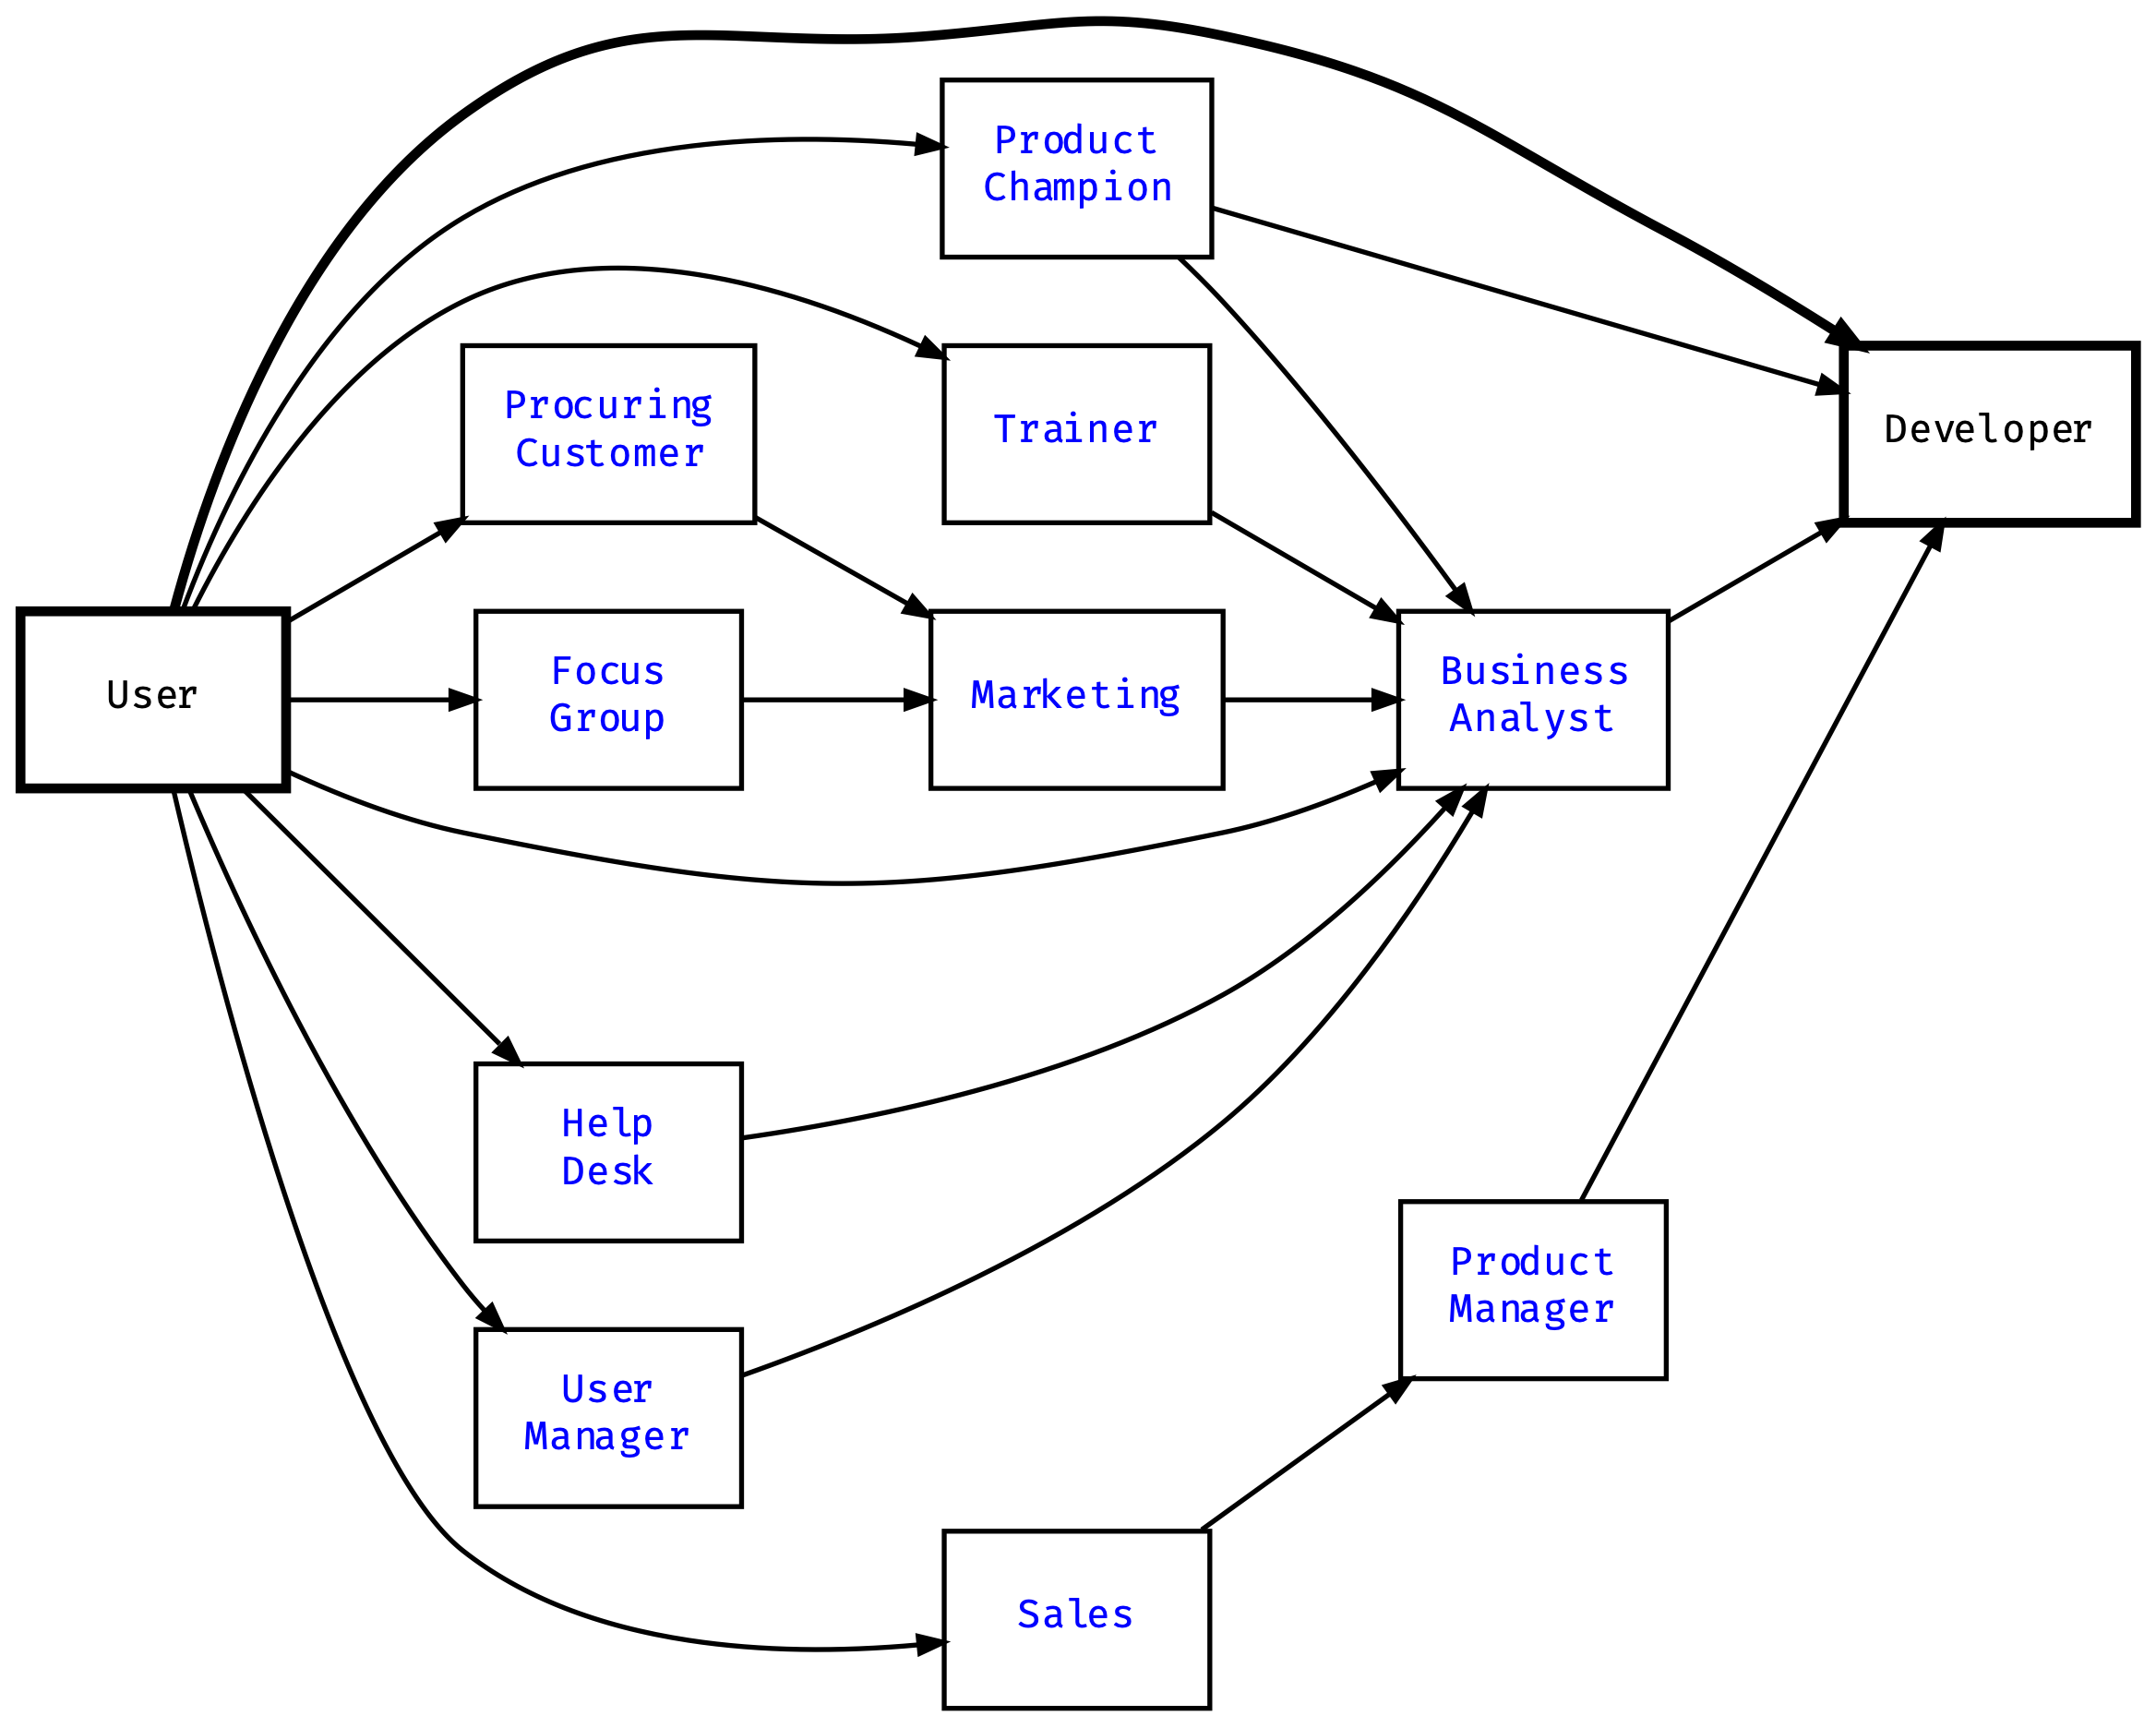
Communication pathways

Slide 13
Product champions
Internal product champions
External product champions
Multiple product champions
Selling the product champion idea

Slide 14
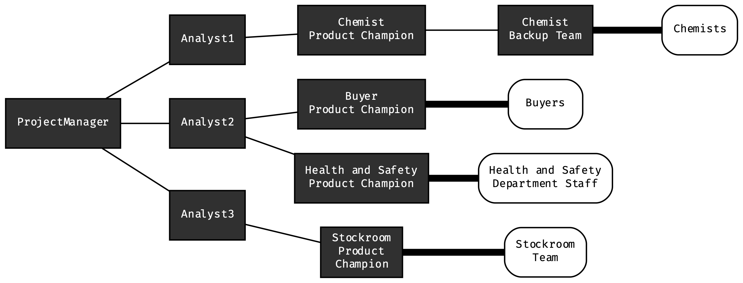
Scaling the product champion role

Slide 15
Resistance to product champions
“The users are too busy”
“Management wants to make all the decisions”
“They’ll slow us down”
“We can’t afford it”
“They’ll run amok, and scope will explode”
“I don’t know what I’m supposed to do as a product champion”

Slide 16
Product champion traps to avoid
Managers who override the product champion’s input
A forgetful product champion
A product champion without a clear vision
A nominated or volunteered product champion

Slide 17
Product champion expectations
Category | Activities
Planning | Refine the scope and limitations of the product Identify other systems with which to interact Evaluate the impact of the new system on business operations | Define a transition path from current applications or manual processes Identify relevant standards and certification requirements
Requirements | Collect input on requirements from other users Develop usage scenarios, use cases, and user stories Resolve conflicts between proposed requirements within the user class Define implementation priorities | Provide input regarding performance and other quality requirements Evaluate prototypes Work with other decision makers to resolve conflicts Provide specialized algorithms
Validation and verification | Review requirements specifications Define acceptance requirements Develop user acceptance tests from usage scenarios | Provide test data sets from the business Perform beta testing or user acceptance testing
User aids | Write portions of user documentation or help text Contribute to training materials or tutorials Demonstrate system to peers
Change management | Evaluate and prioritize defect corrections and enhancement requests Dynamically adjust scope of future releases or iterations | Evaluate the impact of proposed changes on users and business processes Participate in making change decisions

Slide 18
Resolving conflicting requirements
Disagreement between | How to resolve
Individual users | Product champion or product owner decides
User classes | Favored user class gets preference
Market segments | Segment with greatest impact on business success get preference
Corporate customers | Business objectives dictate direction
Users and user managers | Product owner or product champion for the user class decides
Development and customers | Customers get preference, but in alignment with business objectives
Development and marketing | Marketing gets preference

Slide 19
For next week
Leffingwell chapter 7
https://www.insight.com/en_US/learn/content/2017/07312017-finding-the-voice-of-the-customer-in-the-digital-economy.html
In github readings/voc.pdf

